Slide 1
PYGETPAPERS
-VAISHNAVI SHARMA
B.TECH BIOTECHNOLOGY(4TH-YEAR)

Slide 2
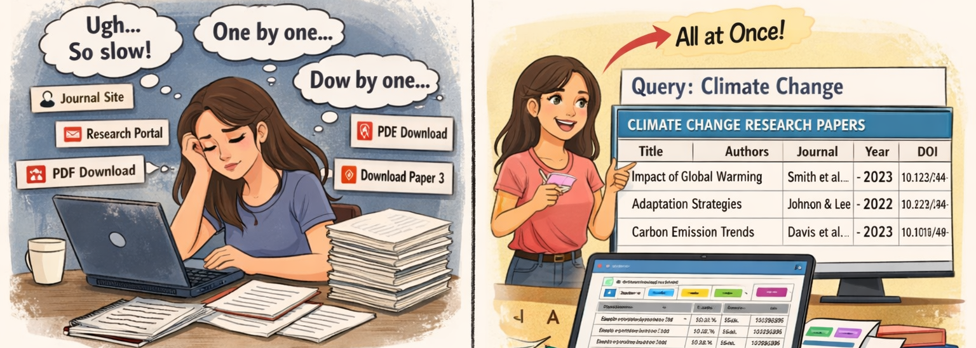
What is pygetpapers?
A Python-based tool that helps users find and download scientific papers from various sources easily.
FIG: MANUAL DOWNLOADING V/S PYGETPAPERS

Slide 3

Installation Command
To install pygetpapers, run this in your terminal
After installation, for verification
TO OVERCOME FALSE POSITIVES (IRRELEVANT INFORMATION) WE GENERATE DATATABLES IN OUTPUT FOR THE REQUIRED QUERY IN PYGETPAPERS.

Slide 4
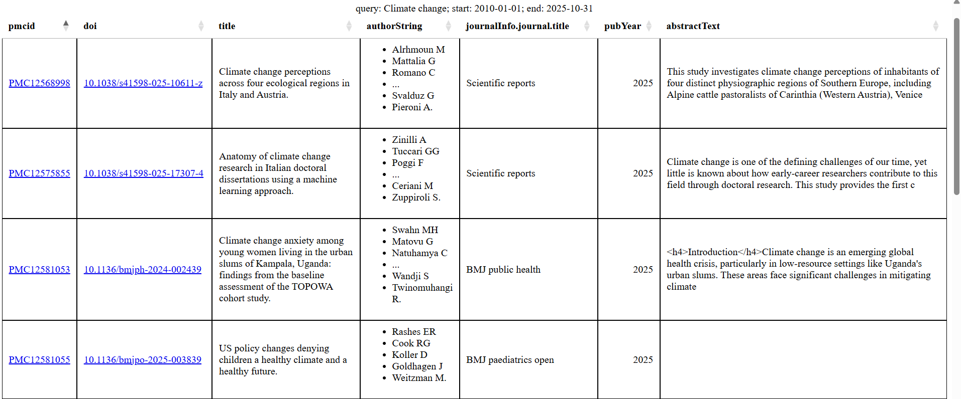
DATATABLE

Slide 5
How pygetpapers Collects Research Papers?
User Input
Connecting to Repositories
Searching for Papers
Collecting Information
You enter search query
OUTPUT FORMATS
JSON
XML
PDF
HTML
Uses APIs to connect to repositories like Europe PMC and bioRxiv.
Sends your request to find papers related to your topic.
Gathers titles, authors, links, and abstracts.

Slide 6
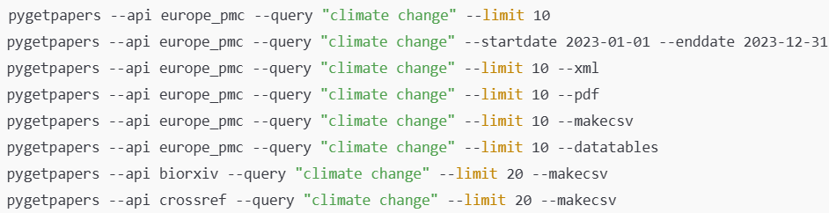
COMMANDS USED

Slide 7
Supported Repositories
Europe PMC
bioRxiv
medRxiv
Crossref
OpenAlex
Redalyc (via Selenium)
API Limits:
Each repository may allow up to 100 papers per request.
User-Defined Limits:
You can specify how many papers you want to download.
LIMITED REPOSITORIES IS A PROBLEM

Slide 8
THANK YOU

